Slide 1
Action Recognition
Juergen Gall

Slide 2
Announcement
3rd Workshop on Consumer Depth Cameras for Computer Vision, Sydney, Australia, 2 December 2013, in conjunction with ICCV'13 Deadline: around 1 September 2013 (tba) http://www.vision.ee.ethz.ch/CDC4CV/

Slide 3
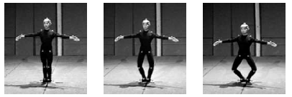
Action Recognition
Most approaches are based on image features like silhouettes, image gradients, optical flow, local space-time features…
Early works used higher level pose information, but required MoCap data or assumed very simple video sequences
[ J. Aggarwal and M. Ryoo. Human activity analysis: A review. ACM Computing Surveys 2011 ]
[ S. Mitra and T. Acharya. Gesture recognition: A survey. TSMC 2007 ]
[ T. Moeslund et al. A survey of advances in vision-based human motion capture and analysis. CVIU 2009 ]
[ R. Poppe. A survey on vision-based human action recognition. IVC 2010 ]
[ L. Campbell and A. Bobick. Recognition of human body motion using phase space constraints. ICCV 1995 ]
[ Y. Yacoob and M. Black. Parameterized modeling and recognition of activities. CVIU 1999 ]

Slide 4

Action Recognition
Pose estimation from depth data is feasible
Depth Maps
Skeleton
[ M. Ye et al. A Survey on Human Motion Analysis from Depth Data. Draft available at http://files.is.tue.mpg.de/jgall/tutorials/visionRGBD13.html ]

Slide 5
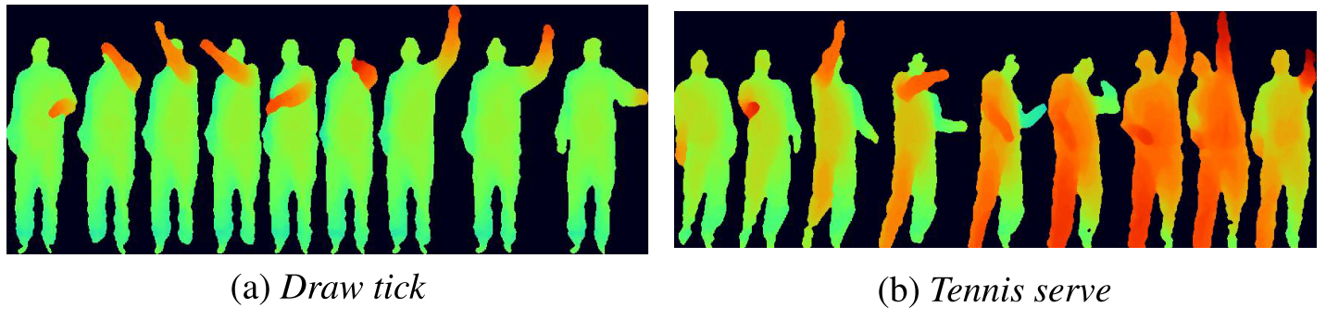
MSR Action3D Dataset
Dataset: 20 actions, 7 subjects, 3 trials, 24k frames @ 15fps
[ W. Li et al. Action recognition based on a bag of 3d points. HAU3D 2010 available at http://research.microsoft.com/en-us/um/people/zliu/actionrecorsrc ]

Slide 6
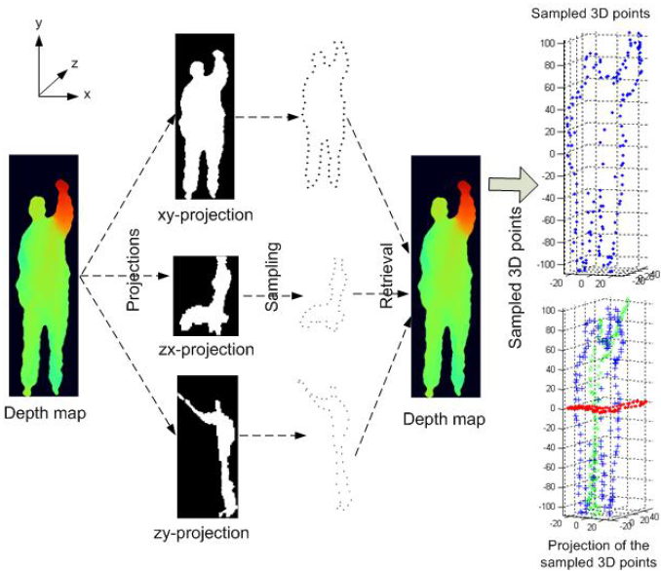
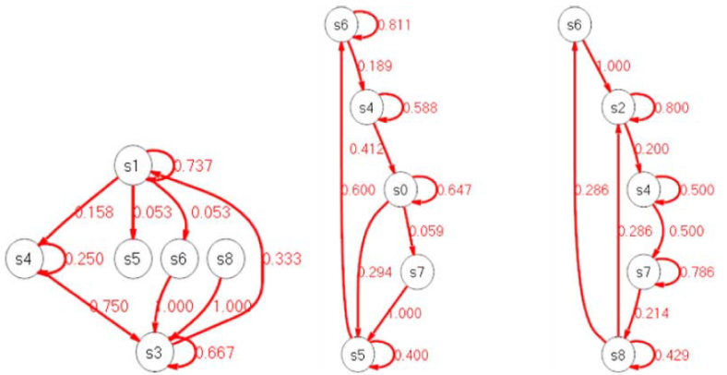
Silhouette Posture
Project depth maps
Select 3D points as pose representation
Gaussian Mixture Model to model spatial locations of points
Action Graph:
[ W. Li et al. Action recognition based on a bag of 3d points. HAU3D 2010 ]

Slide 7
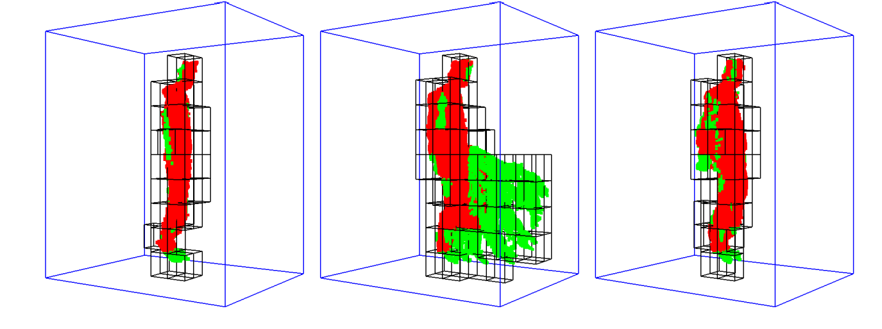
Space-Time Occupancy Patterns
Silhouettes are sensitive to occlusion and noise
Clip (5 frames) as 4D spatio-temporal grid
Feature vector: Number of points per cell
[ A. Vieira et al. STOP: Space-Time Occupancy Patterns for 3D Action Recognition from Depth Map Sequences. LNCS 2012 ]

Slide 8
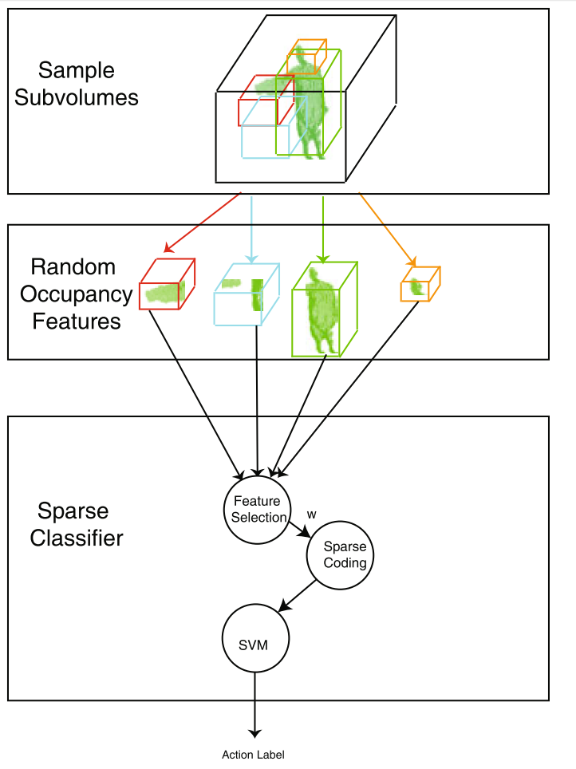
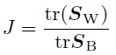
Random Occupancy Patterns
Compute occupancy patterns from spatio-temporal subvolumes
Select subvolumes based on Within-class scatter matrix (S_{W}) and Between-class scatter matrix (S_{B}):
Sparse coding + SVM
[ J. Wang et al. Robust 3d action recognition with random occupancy patterns. ECCV 2012 ]

Slide 9
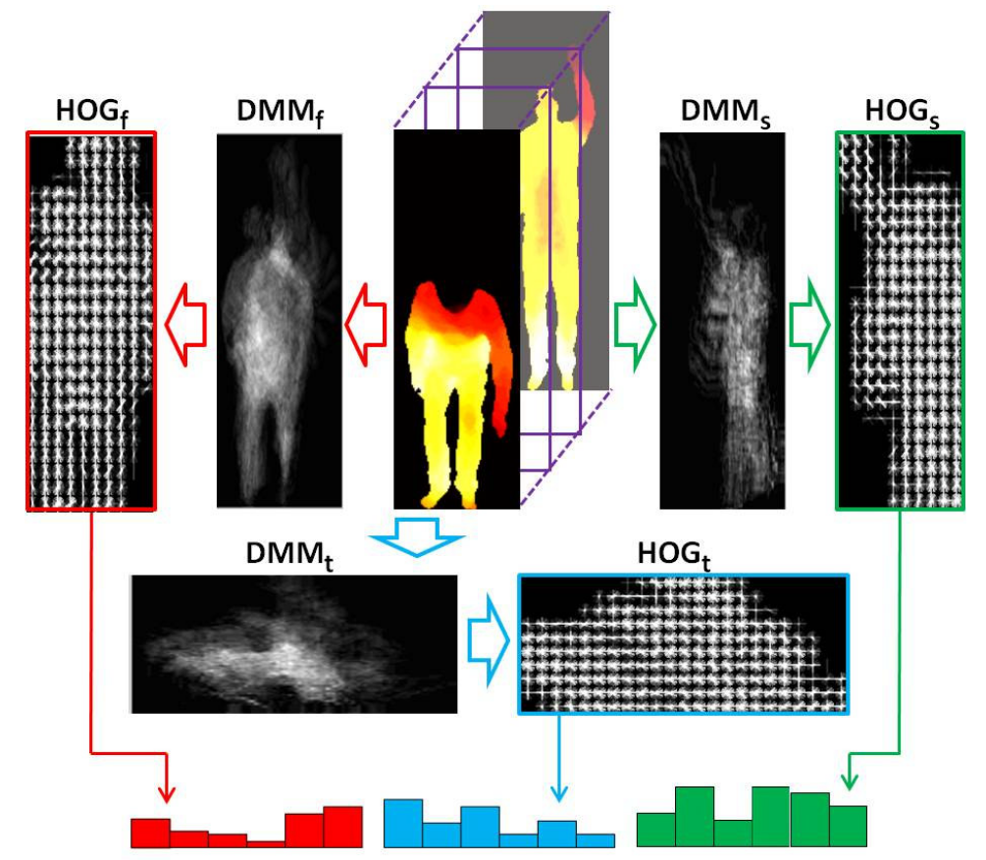
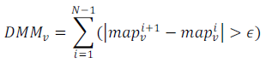
Depth Motion Maps
Project depth maps and compute differences:
HOG + SVM
[ X. Yang et al. Recognizing actions using depth motion maps-based histograms of oriented gradients. ICM 2012 ]

Slide 10
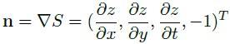
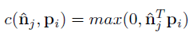
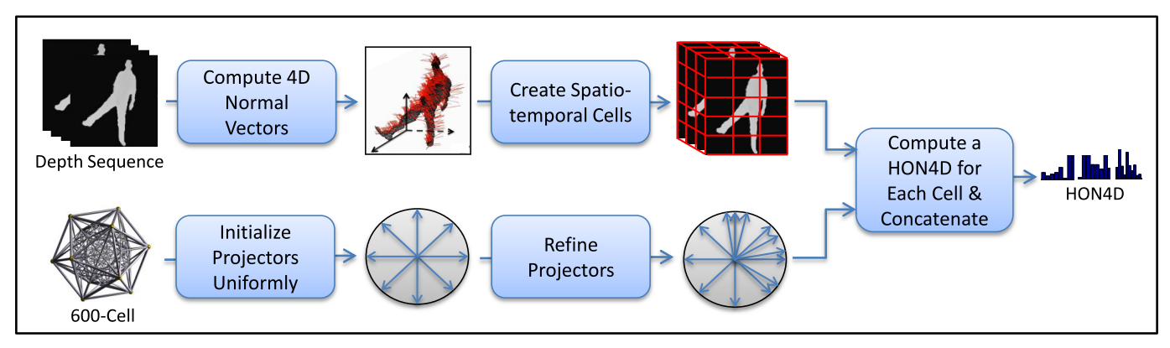
Histogram of 4D Surface Normals
Surface normals:
Quantization according to “projectors” p_{i}:
Add additional discriminative “projectors”
[ O. Oreifej and L. Zicheng. Hon4d: Histogram of oriented 4d normals for activity recognition from depth sequences. CVPR 2013 available at http://www.cs.ucf.edu/~oreifej/HON4D.html ]

Slide 11
Depth and Color
4D local spatio-temporal features (RGB+D)
Fine-Grained Kitchen Activity Recognition
Datasets
[ H. Zhang and L. Parker. 4-dimensional local spatio-temporal features for human activity recognition. IROS 2011]
[ L. Lei et al. Fine-grained kitchen activity recognition using rgb-d. UbiComp 2012 ]
[ F. Ofli et al. Berkeley MHAD: A Comprehensive Multimodal Human Action Database. WACV 2013 available at http://tele-immersion.citris-uc.org/berkeley_mhad ] [J. Sung et al. Human Activity Detection from RGBD Images. PAIR 2011 available at http://pr.cs.cornell.edu/humanactivities ] [B. Ni et al. RGBD-HuDaAct: A Color-Depth Video Database for Human Daily Activity Recognition. CDC4CV 2011 available at https://sites.google.com/site/multimodalvisualanalytics/dataset ]

Slide 12
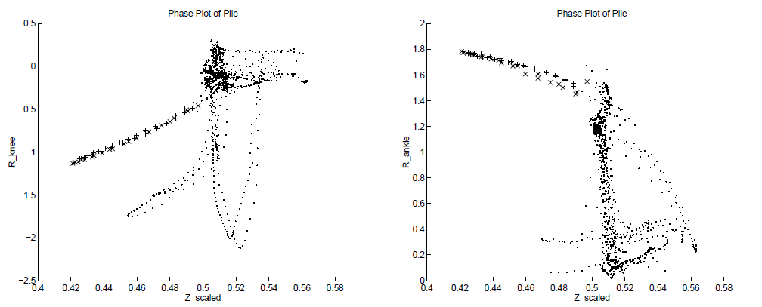
Joints as Feature
Recognizing nine atomic ballet movements from MoCap data
Curves in 2D phase spaces (joint ankle vs. height of hips)
Supervised learning for selecting phase spaces
[ L. Campbell and A. Bobick. Recognition of human body motion using phase space constraints. ICCV 1995 ]

Slide 13
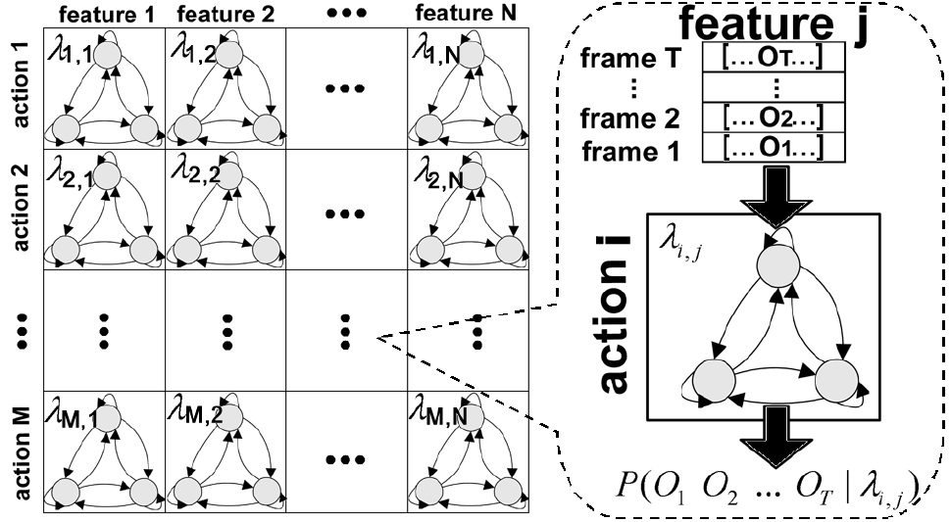
HMMs
Dynamics of single joints modeled by HMM
HMMs as weak classifiers for AdaBoost
[ F. Lv and R. Nevatia. Recognition and segmentation of 3-d human action using hmm and multi-class adaboost. ECCV 2006 ]

Slide 14
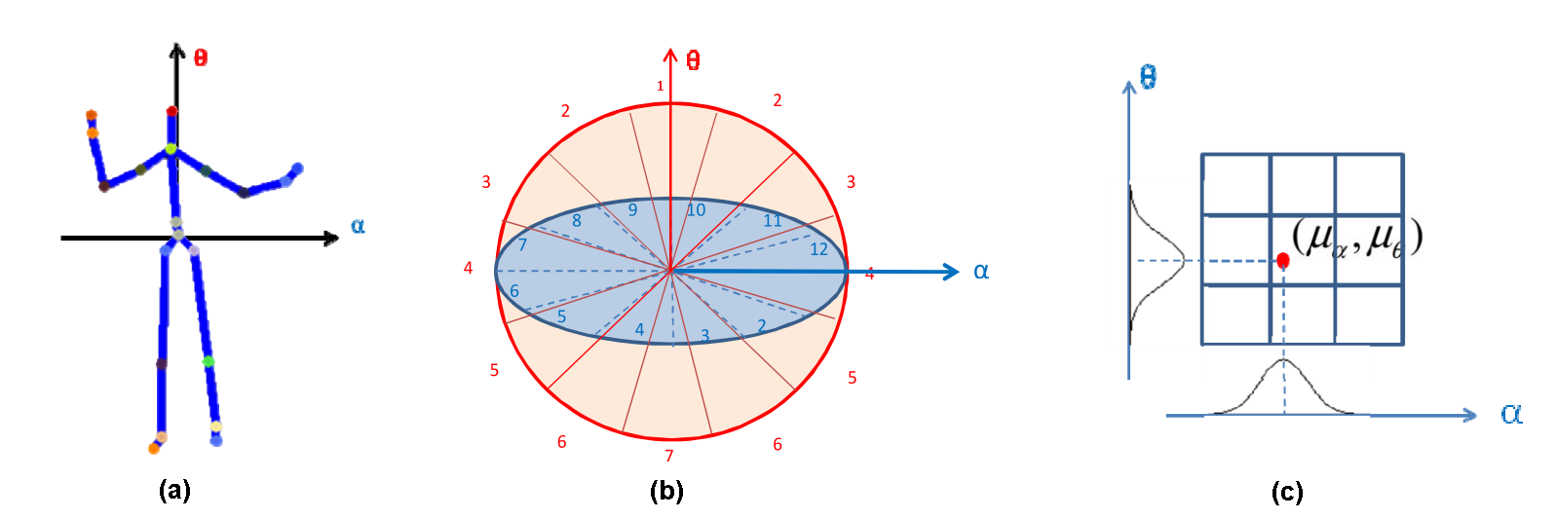
Histogram of 3D Joint Locations
Joint locations relative to hip in spherical coordinates
Quantization using soft binning with Gaussians
LDA + Codebook of poses (k-means) + HMM
[ L. Xia et al. View invariant human action recognition using histograms of 3d joints. HAU3D 2012 ]

Slide 15
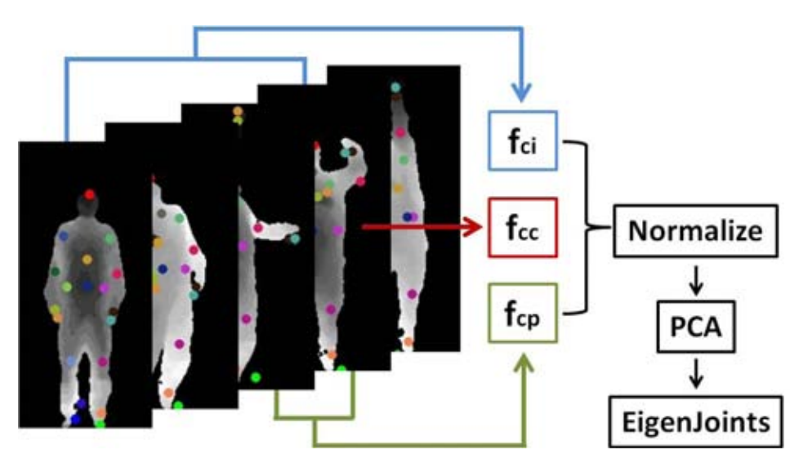
EigenJoints
Combine features: f_{cc}: spatial joint differences f_{cp}: temporal joint differences f_{ci}: pose difference to initial pose
[ X. Yang and Y. Tian. Eigenjoints-based action recognition using naive-bayes-nearest-neighbor. HAU3D 2012 ]

Slide 16
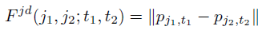
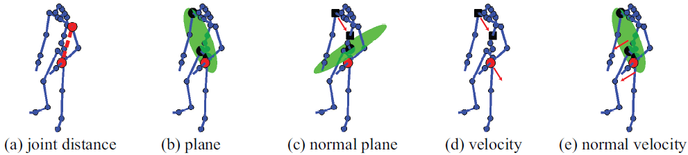
Relational Pose Features
Spatio-temporal relation between joints, e.g.,
Classification and regression forest for action recognition
[ A. Yao et al. Does human action recognition benefit from pose estimation? BMVC 2011 ]
[ A. Yao et al. Coupled action recognition and pose estimation from multiple views. IJCV 2012 ]

Slide 17
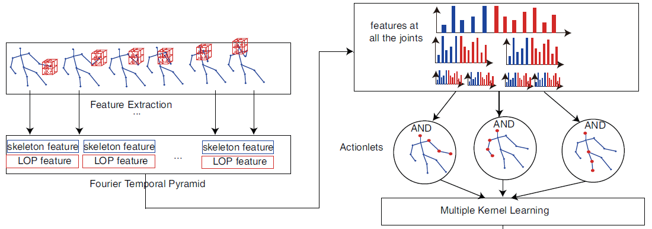
Depth and Joints
Local occupancy features around joint locations
Features are histograms of a temporal pyramid
Discriminatively select actionlets (subsets of joints)
[ J. Wang et al. Mining actionlet ensemble for action recognition with depth cameras. CVPR 2012 ]

Slide 18
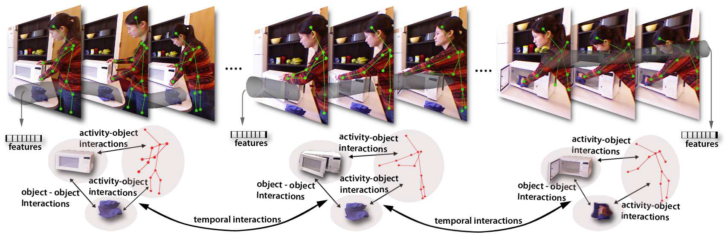
Pose and Objects
Spatio-temporal relations between human poses and objects
[ L. Lei et al. Fine-grained kitchen activity recognition using rgb-d. UbiComp 2012 ]
[ H. Koppula et al. Learning human activities and object affordances from rgb-d videos. IJRR 2013 ]

Slide 19
Thank you for your attention.

